Slide 1
论文分享 Informer: Beyond Efficient Transformer for Long Sequence Time-Series Forecasting
汇报人：彭美政
日期：2021.3.31

Slide 2
Background
Motivation: Why attention?
Methods: The details of Informer
Experiments
Summary

Slide 3
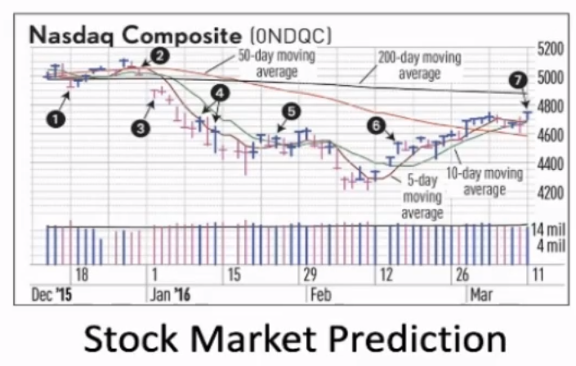
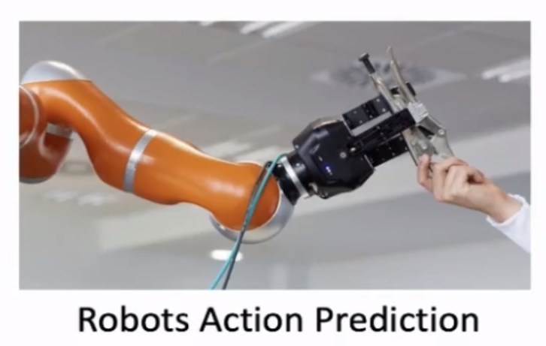
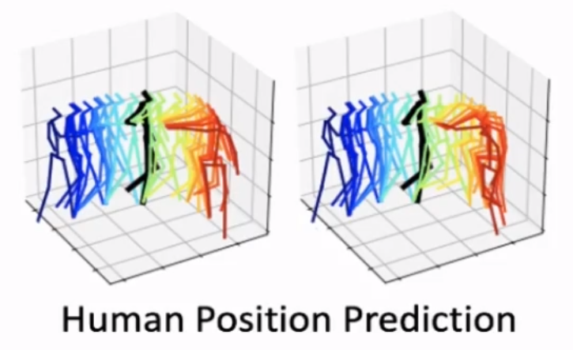
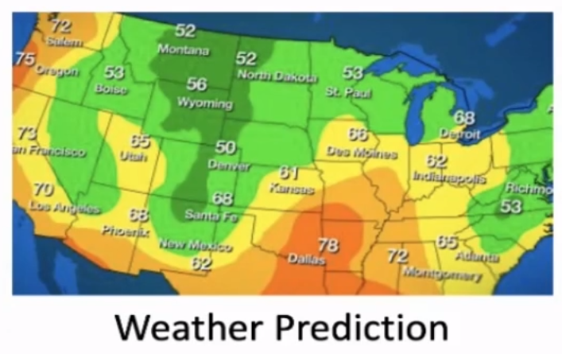
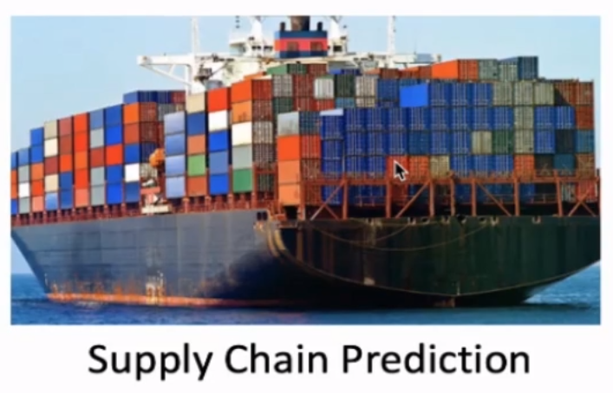

Main topic of this paper
Sequence prediction is a problem that involves using historical sequence information to predict the next value or values in the sequence. It is a basic but important research problem.

Slide 4
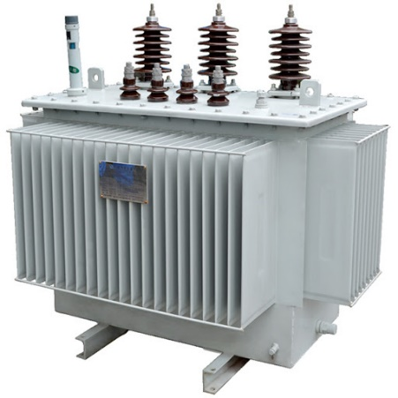
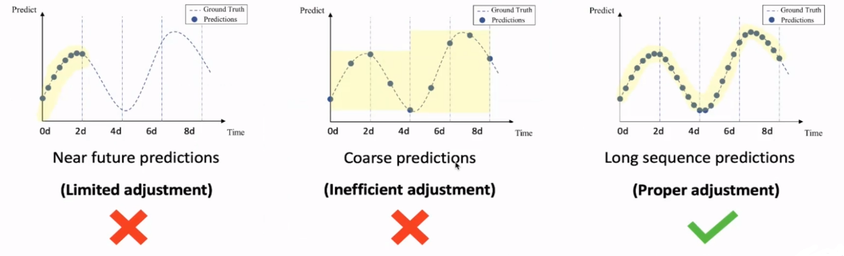
An example
Electricity Transformer (over 100kv) is a valuable asset for the energy company. The cost of a single unit can reach 30 million US dollars, which makes only conservative adjustments are allowed, i.e., one adjustment lasts 2 weeks, for stability.
Notes:
从所有可能的网络结构空间搜索最优贝叶斯结构是一个NP难题, 两种方式求得近似解:贪心算法(评价函数);限定网络结构
结构也可由专家确定;

Slide 5
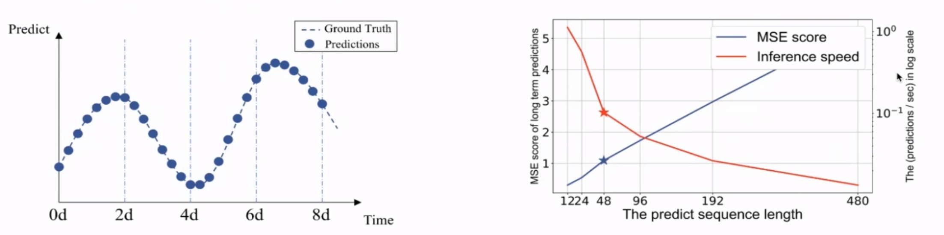
Long Sequence Time-series Forecasting
Problem: Long Sequence Time-series Forecasting (LSTF) is an important problem that has not been well addressed in the time-series analysis field for a long time.On the other hand,because of the “huge data,high frequency, long prediction”features of the real-world time-series data, this problem is one of the key limitation in big data applications.
As the length of the data sequence increases, the inference speed of LSTM decreases rapidly, resulting in the inability to predict long sequences with limited computing power and time successfully. Meanwhile, the continuous accumulation of error causes the MSE score to increase rapidly, making the results unusable.

Slide 6

Another Similar Problem
Discrimination: Long Sequence Input learning (LSIL) is another important problem thatremains to be solved in the machine learning field. lt is not necessary related to the LSTF problem but the literature always refers to LSIL when talking about the long sequence.
Example:
Input:
Output:
Classification: All-age Novels
Title Summary: A boy wizard begins training and must battle for his life with the Dark Lord who murdered his parents.

Slide 7
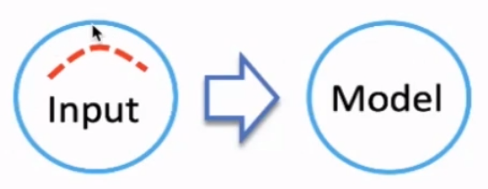
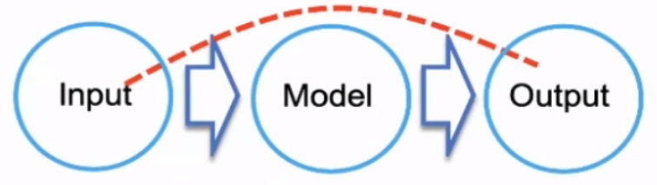
We address the LSTF problem in this paper
Long Sequence Input Learning Problem
Enhance the model’s ability to handle massive inputs. The most important thing is to capture the long term independencies among the long sequence inputs.
Long Sequence Input Learning Problem
Enhance the model’s prediction capacity to have a more extended output. The most important thing is to capture the long term independencies between the long sequence output and the inputs.

Slide 8
Background
Motivation: Why attention?
Methods: The details of Informer
Experiments
Summary

Slide 9


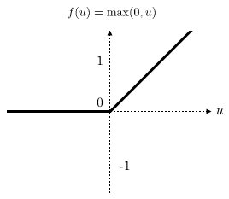

How do human beings tackle the forecasting problem?
Problem Setting: Long Sequence Forecasting predicts the long sequence output from massive long sequence inputs.
How do we answer a question?
What is Relu() ?
Machine Learning
How do we plan gifts for Christmas day?
The gifts list for this year?
Popular things?
Last year?
Wish list?

Slide 10
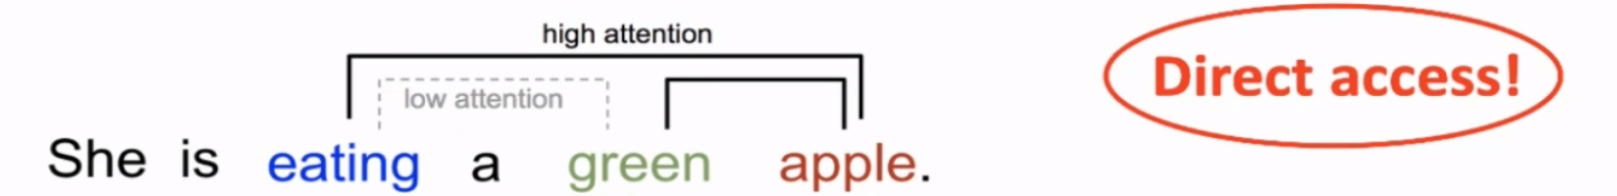
The intuitive introduction of attention
Attention Mechanism is arguably one of the most powerful concepts in the deep learning field nowadays. It is based on a common intuition that we “attend to” a certain part when processing a large amount of information.
Example:
we can explain the relationship between words in one sentence or close context. When we see “eating”, we expect to encounter a food word very soon.The color term describes the food, but probably not so much with"eating"directly.

Slide 11
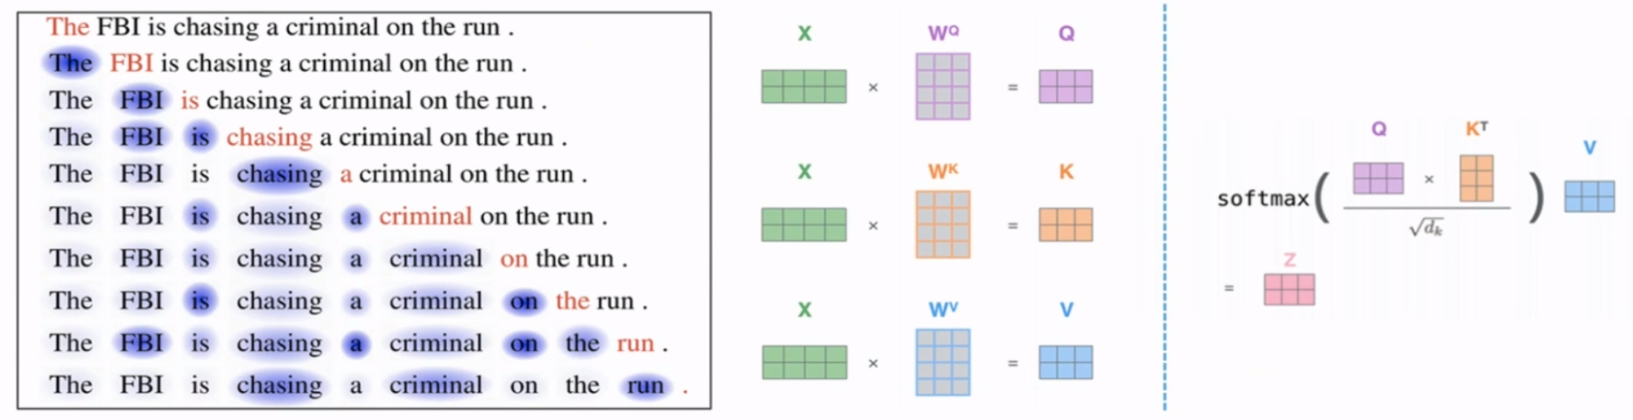
The self-attention in NLP field

Slide 12
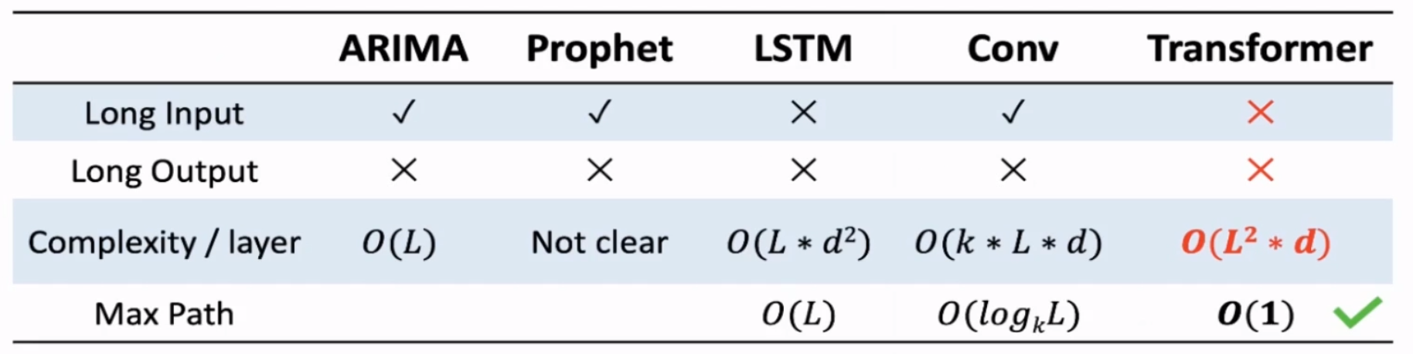
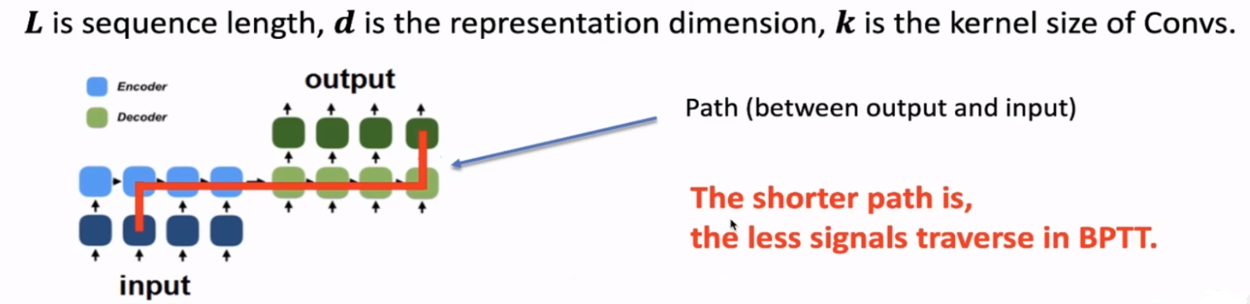
If we use Transformer in LSTF problem

Slide 13
Background
Motivation: Why attention?
Methods: The details of Informer
Experiments
Summary

Slide 14
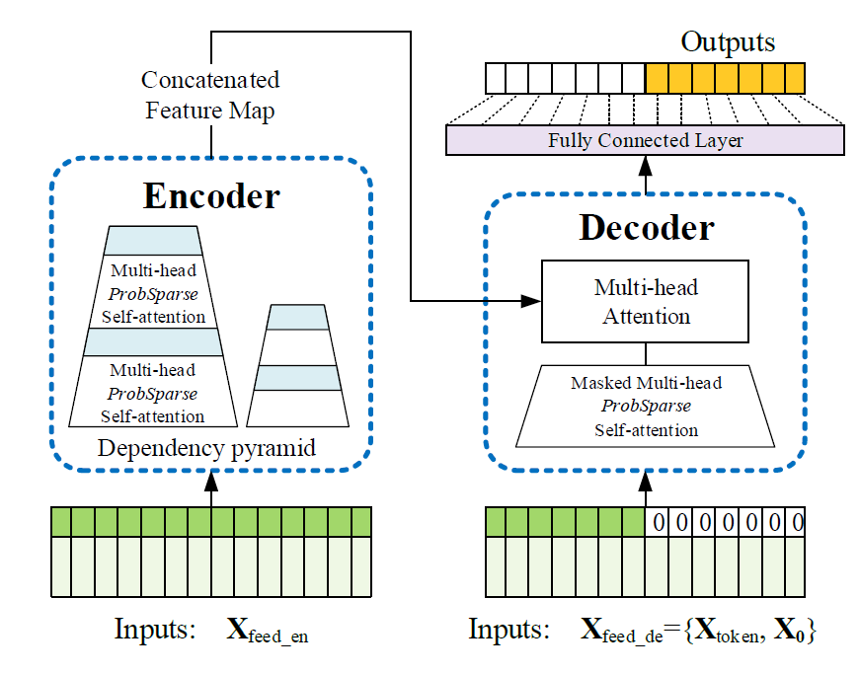
Challenges
The quadratic computation of self-attention
The atom operation of self-attention mechanism namely canonical dot-product, causes the time complexity and memory usage per layer to be O(L²). [Complexity/layer]
The memory bottleneck in stacking layers
The stack of J encoder/decoder layer makes total memory usage to be O(J*L²), which limits the model scalability on receiving long sequence inputs. [Long Input]
The speed plunge in predicting long output
The dynamic decoding of Transformer makes the inference speed as slow as RNN-based model. [Long Output]

Slide 15
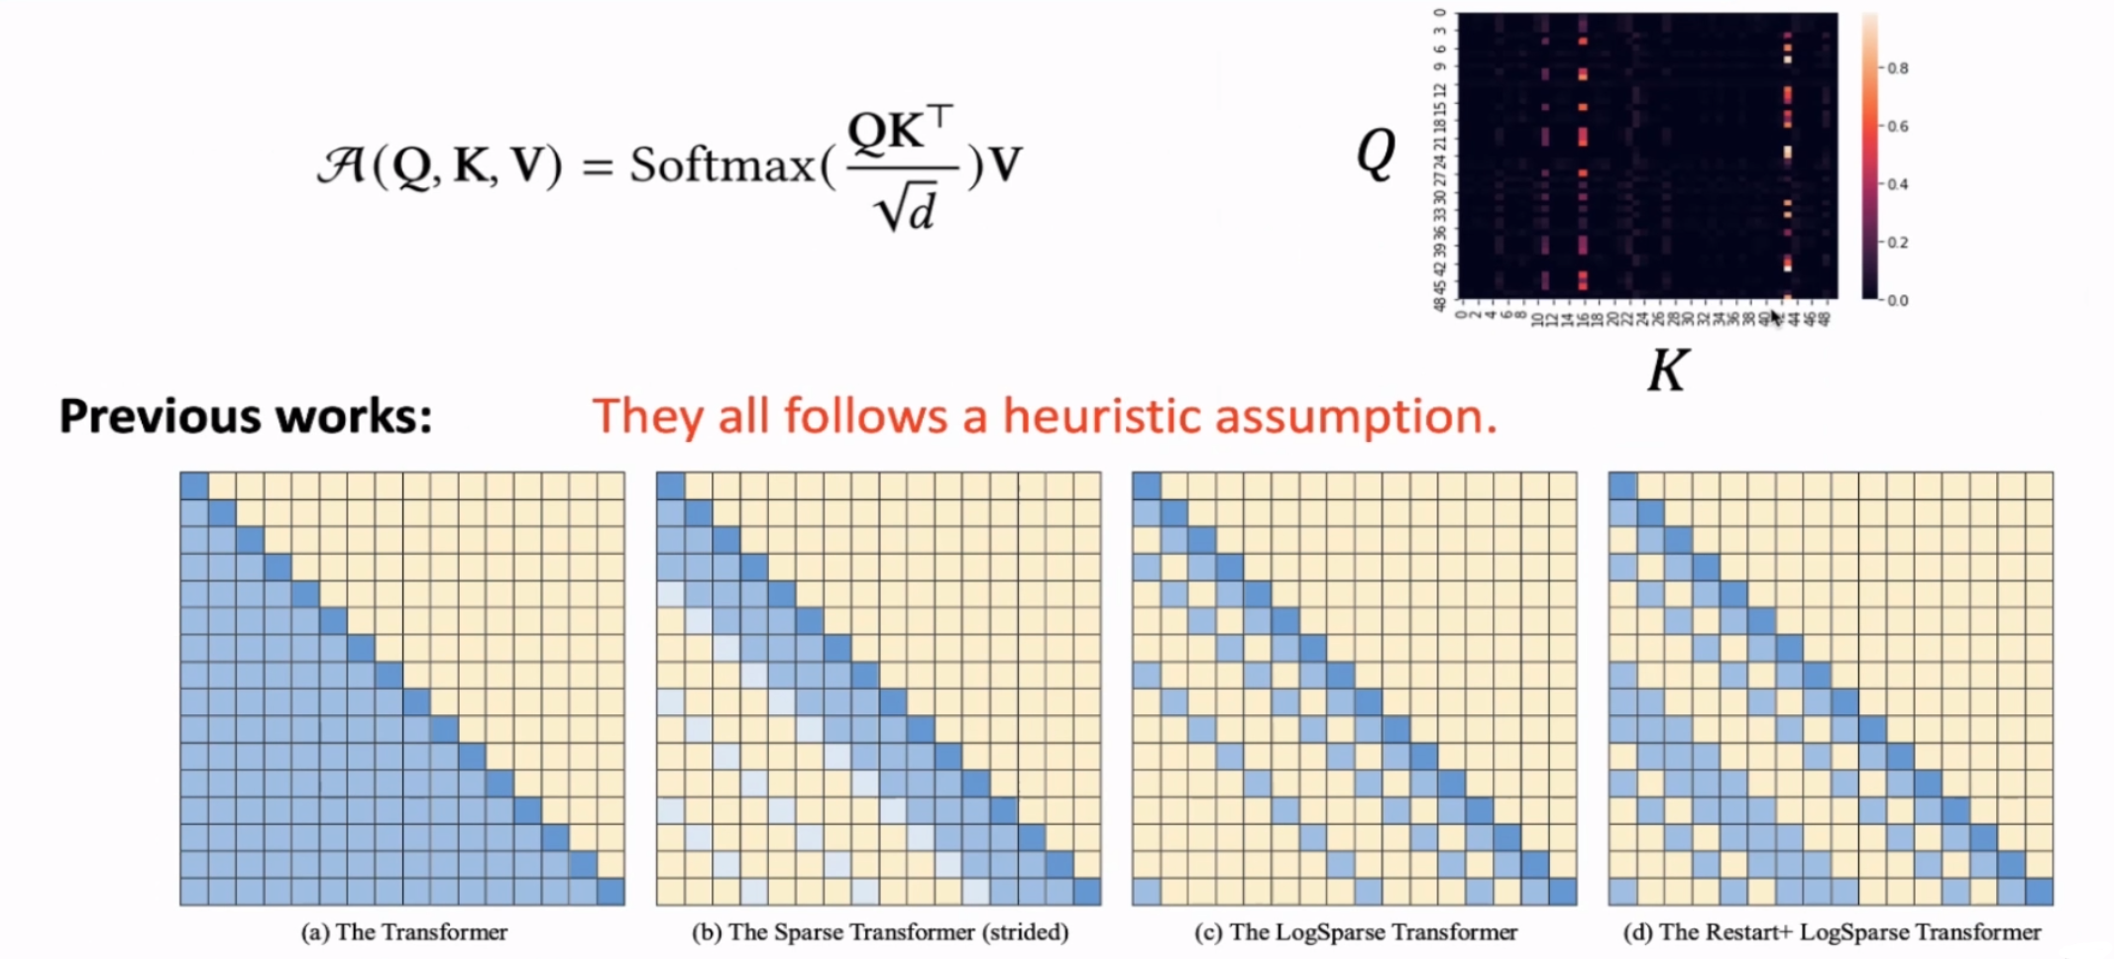
Challenge I: Self-attention Mechanism

Slide 16
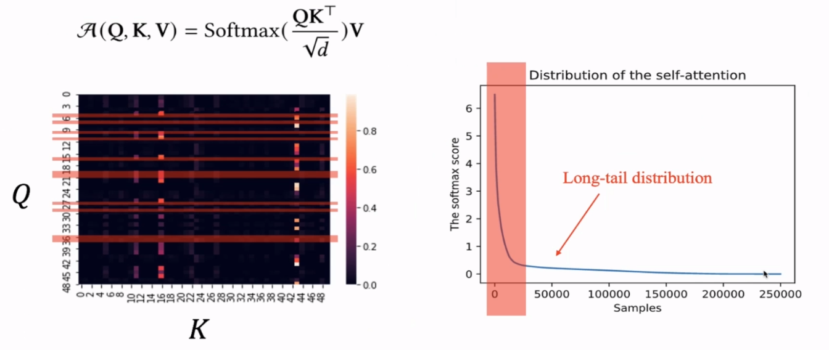
Challenge I: Self-attention Mechanism

Slide 17
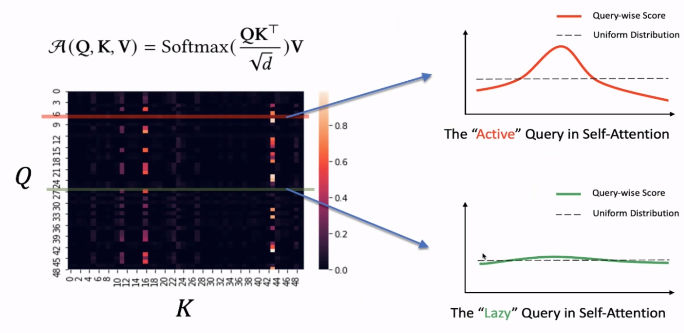
Challenge I: Self-attention Mechanism

Slide 18
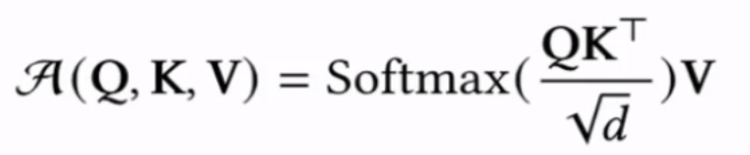
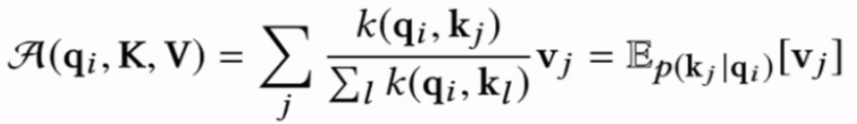
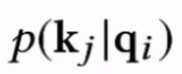
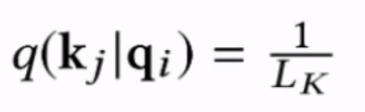
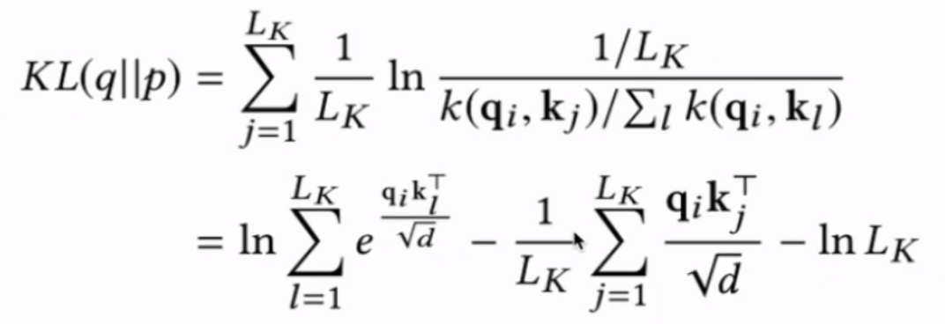
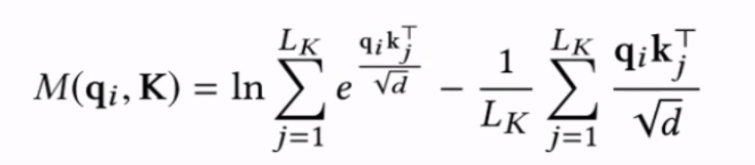
Challenge I: Self-attention Mechanism
Rewrite the original self-attention into the probability formulation
Establish the measurement
attention probability
uniform probability

Slide 19
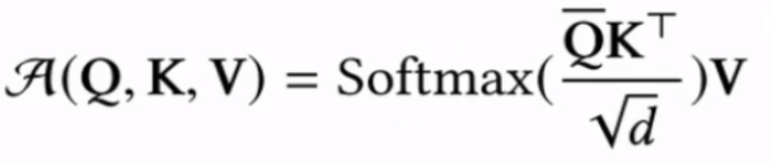
Challenge I: Self-attention Mechanism
Rewrite the original self-attention into the probability formulation
Establish the measurement
Define ProbSparse self-attention
Based on proposed measurement, we have the ProbSparse Self-attention by allowing each key only to attend to the u dominate queries, namely the “Active” queries

Slide 20
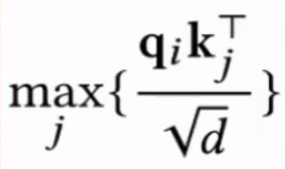
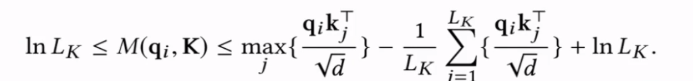
Challenge I: Self-attention Mechanism
Rewrite the original self-attention into the probability formulation
Establish the measurement
Define ProbSparse self-attention
The measurement have to calculate each dot-product pairs, which still requires O(L²) computation. And the LSE func has the numerical stability issue.

Slide 21
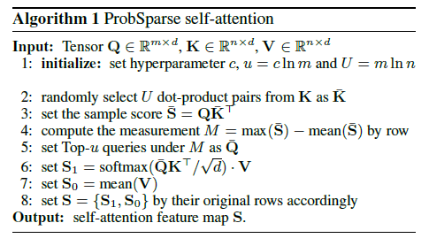
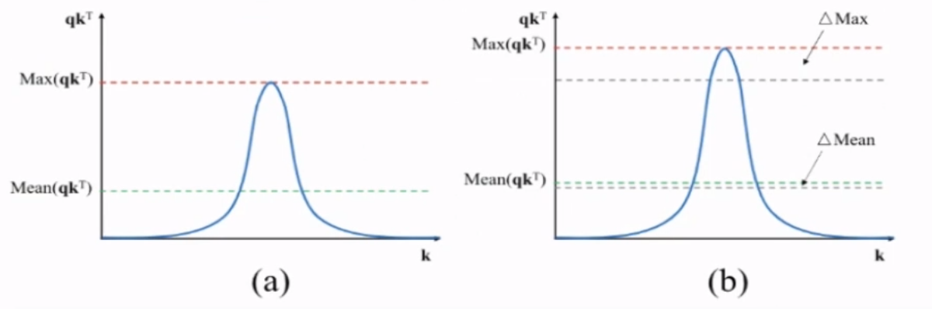
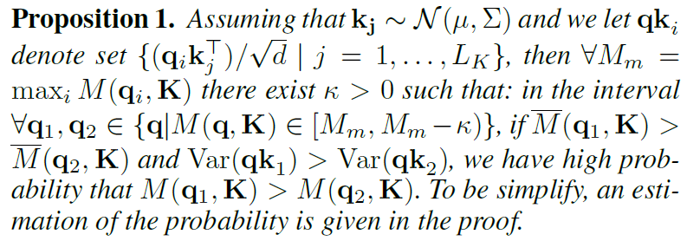
Challenge I: Self-attention Mechanism
Rewrite the original self-attention into the probability formulation
Establish the measurement
Define ProbSparse self-attention
Use an empirical approximation to the measurement
sample L log L dot-product pairs

Slide 22
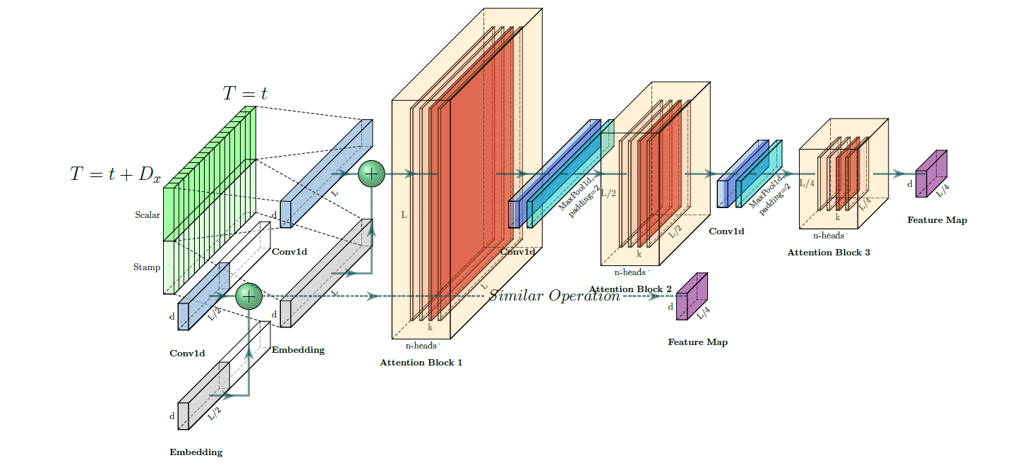
Challenge II: Self-attention Distilling Operation
Self-attention Destilling
Enhance robustness of distilling operation
Build replicas by halving the inputs

Slide 23
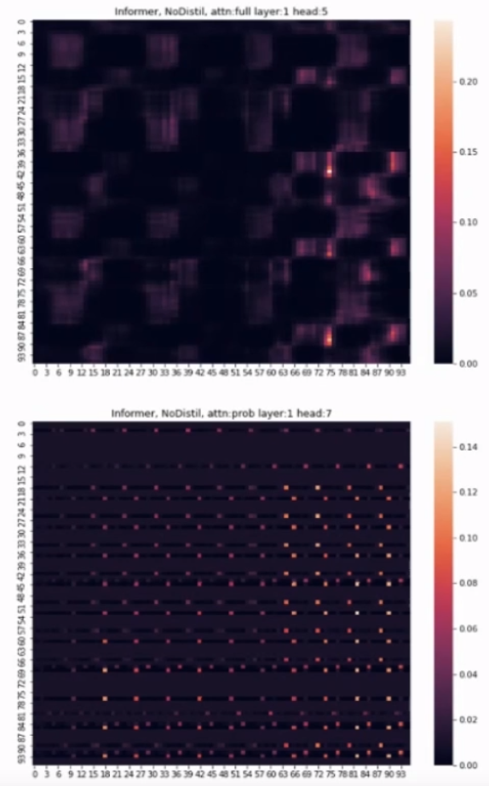
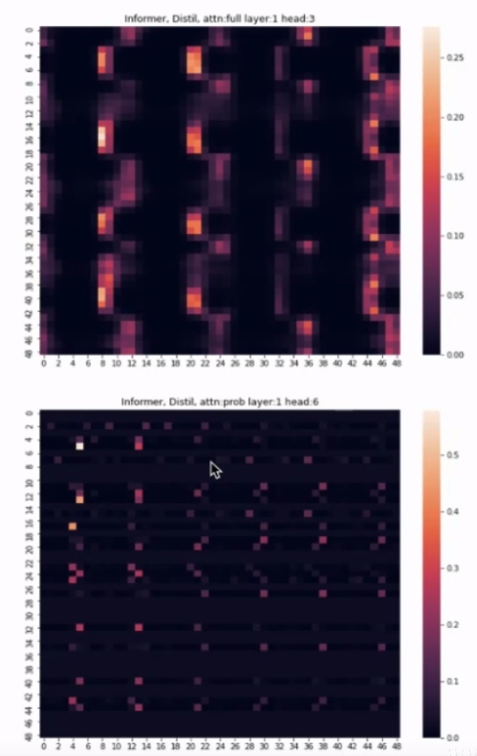
Challenge II: Self-attention Distilling Operation

Slide 24
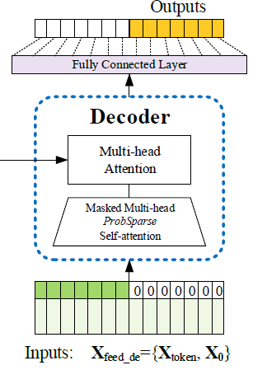
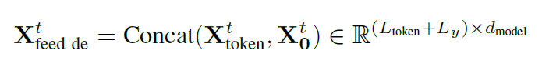
Challenge III: Generative-style Decoder
Start token is an efficient technique in NLP “dynamic decoding”, especially for per-training model, and we extend itinto a generative way.
lnstead of choosing a specific flag as the token, we sample a “shorter” long sequence in input sequence, which is an earlier slice before output sequence.
Take predicting 480 points as an example (5-day predictionin the ETT dataset), we will take the known 5 days before this time sequence as “start-token”, and feed the generative-style inference decoder with them.

Slide 25
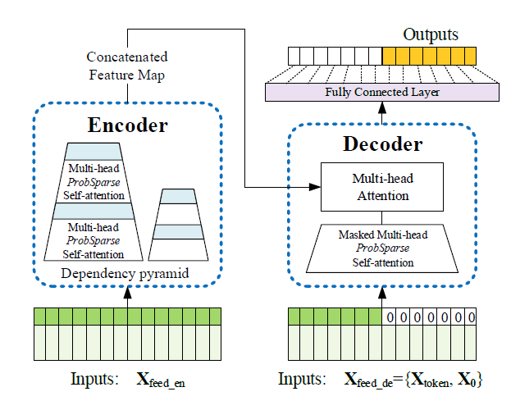
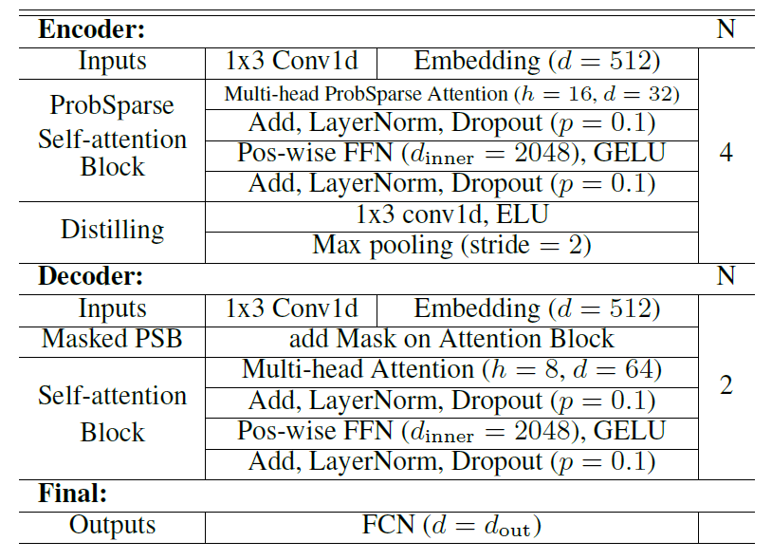
The overall architecture of the Informer model

Slide 26
Background
Motivation: Why attention?
Methods: The details of Informer
Experiments
Summary

Slide 27
Experiment setting
Datasets
ETT(Electricity Transformer Temperature):
2 stations, 2 years, every 15 minutes. Train/Val/Test is 12/ 4 / 8 months.
ECL (Electricity Consuming Load):
1 country, 2 years, every 1 hour. Train/Val/Test is 15/ 3 / 6 months.
Weather:
1600 US locations,4 years, every 1 hour. Train/Val/Test is 28/ 10 / 10 months.
Baselines
Time-series methods: ARIMA, DeepAR,Prophet, LSTMa, LSTnet
Transformer-based methods: vanilla Transformer, Reformer, LogSparse Transformer
Metrics
Mean Absolute Error (MAE),Mean Squared Error (MSE).

Slide 28
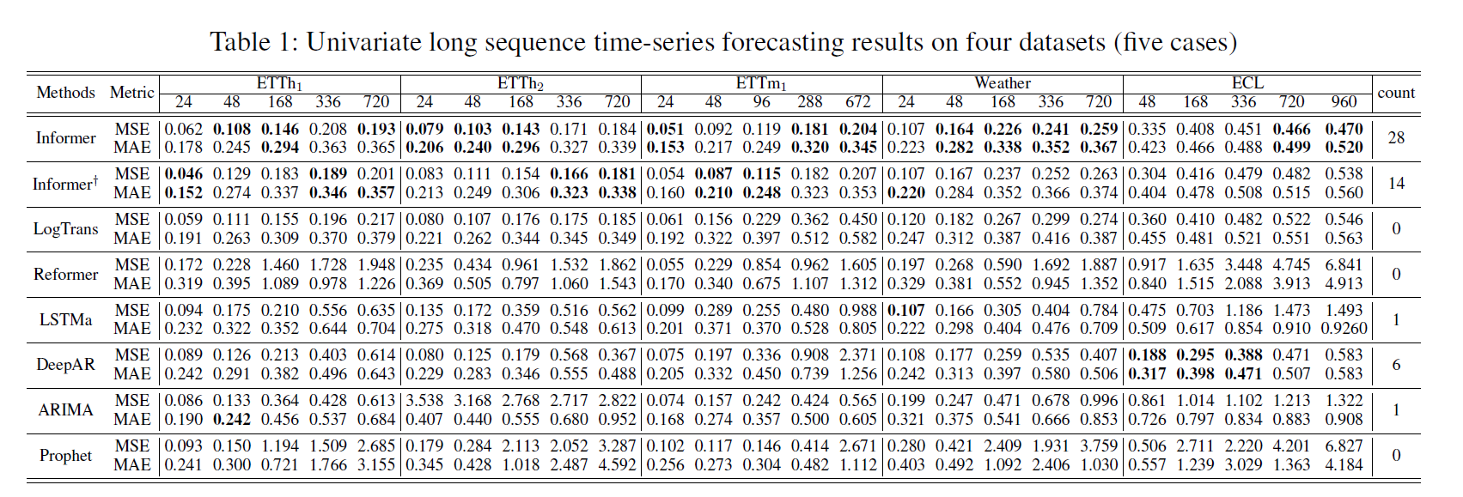
Experiment results
The Informer greatly improves the inference performance.
The Informerand its canonical degradation Informer+ show comparable performance and lnformer beatslnformer mostly in wining-counts, i.e.28>14.
Our proposed methods achieve better results than Reformer and LogTrans.

Slide 29
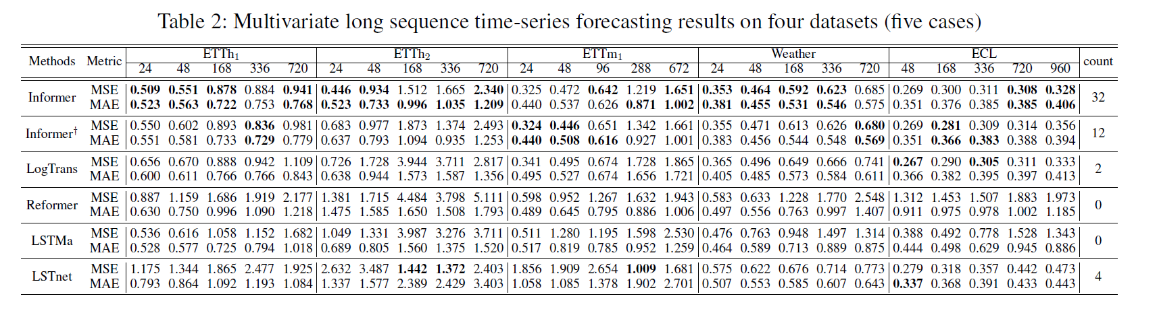
Experiment results
The Informer greatly improves the inference performance.
The Informer and its canonical degradation Informer+ show comparable performance and Informer beats Informer+ mostly in wining-counts, i.e.32>12.
The previous conclusion in multivariate case holds.

Slide 30
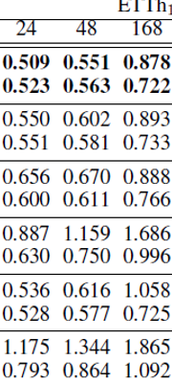
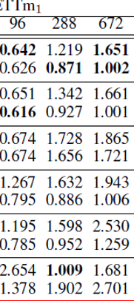
Experiment results

Slide 31
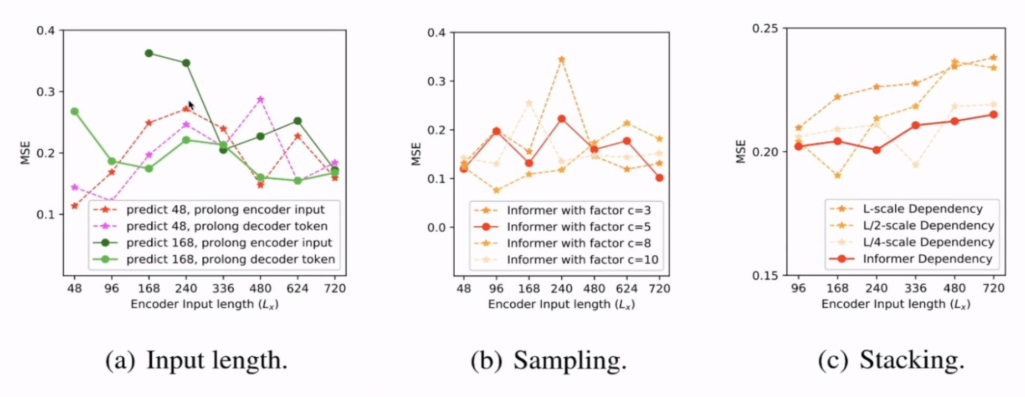
Experiment results

Slide 32
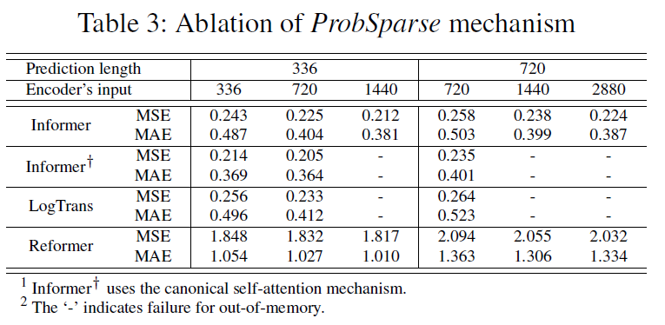
Experiment results

Slide 33
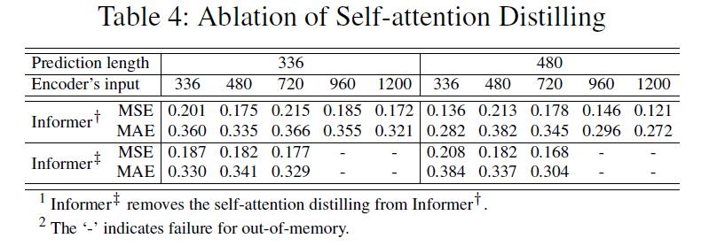
Experiment results

Slide 34
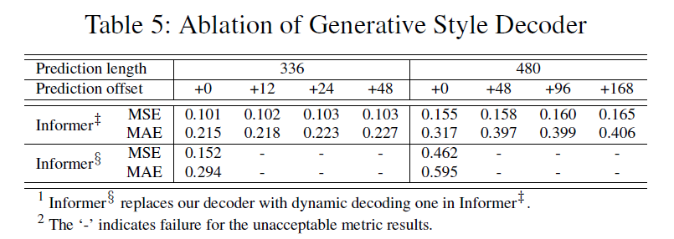
Experiment results

Slide 35
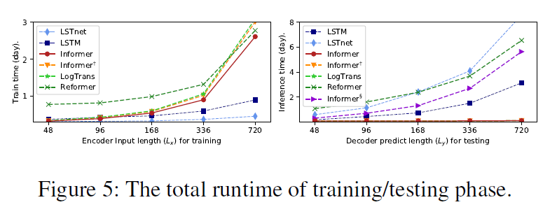
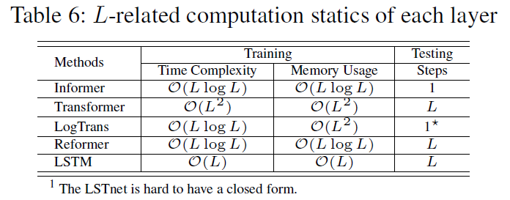
Experiment results

Slide 36
Background
Motivation: Why attention?
Methods: The details of Informer
Experiments
Summary

Slide 37
Summary
自注意力模型在处理时间序列问题当中具有相当的可行性，但是存在着输入输出受限、时间复杂度和内存开销较高的问题。
作者提出了三个创新点：
ProbSparse Self-attention, 更高效的自适应注意力计算方法，同时具有可解释性。
Self-attention Destilling Operation, 减小内存开销，使得更长输入序列成为可能。
Generative-style Decoding，一次生成预测结果，使得更长输出序列成为可能。
稀疏性假设在处理自注意力问题上具有很显著的作用。
本文提出的方法在NLP中的生成式文本摘要等领域可能具有很大帮助。

Slide 38
Thanks for watching
彭美政，2021.3.31

